Slide 1

Data Science at bol.com
Jasper Adegeest & Manuel Spierenburg
Data Science Workshop, 2022-12-02

Slide 2






And of course we do some data heavy lifting
13 million active customers across NL & BE
47 million products for sale
112 million visits in our shop per month
50k partners on our platform
Notes:
For the products and partners: we can reference that our full catalogue is much bigger still, that we have detailed product information for each product (title, description, attributes, images), that we get thousands of product updates per day.
Customers: 13 million active customers also buy a lot of things, meaning we send thousands of products per day
Visits: reference to the wealth of interaction data this generates

Slide 3

Data Science is present at every step of the journey
Making sure the shop is properly stocked
Forecasting sales
Keeping the shop clean and safe
Optimizing product content
Detecting fraudsters
Helping the customer find the right product
Recommendations
Getting the package to your doorstep
Warehouse optimization

Slide 4

Data Science at bol.com
>50 data scientists and machine learning engineers
Across ~20 different teams
Data science impacts over 200 people in their daily work
There is still a lot to do

Slide 5

But what does that actually look like in practice?

Slide 6

Data Science Content Team
Products we have:
Loris: Predict the category for a product by title and description
FML: Predict if a product should be added to a family
Butterfly: Detect overlays on images so they are not used for advertisement

Slide 7
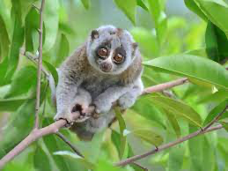
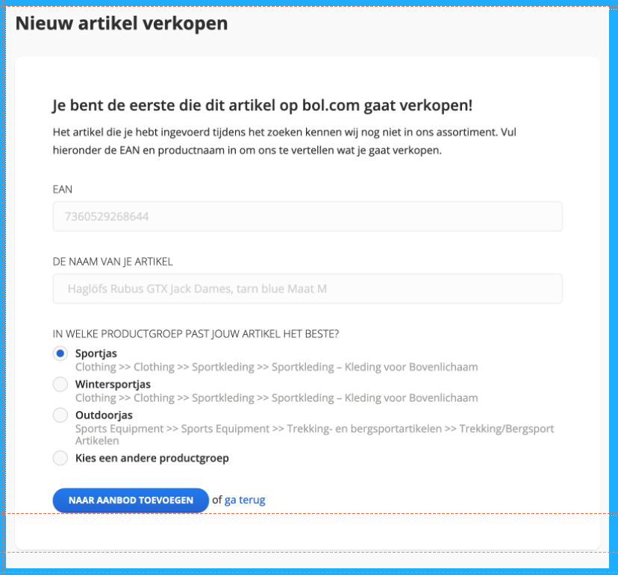
Loris
What does it do?
Predicting the chunk of a product
Why do we need it?
5000+ chunks within bol.com
Chunk determines a lot
So correct chunk is very important
Where is it used
Delivery flow of new products

Slide 8

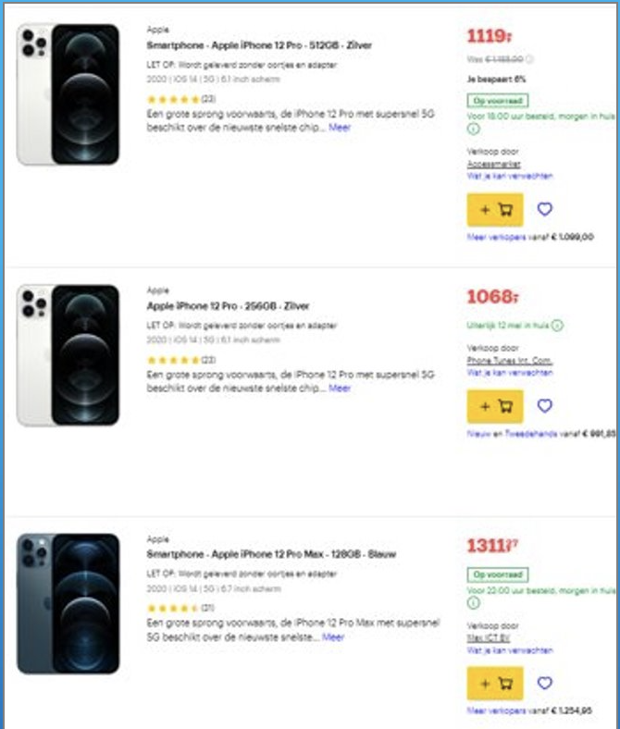
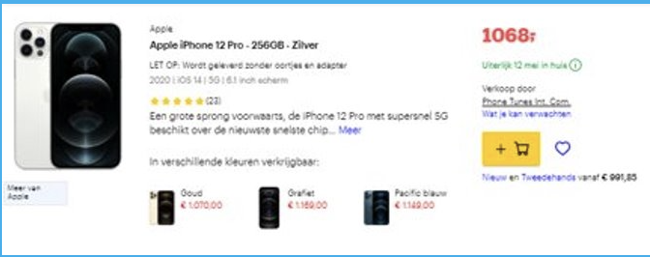
FML
What does it do?
Predicting if products should be grouped into a family
Why do we need it?
Cleaner and user-friendly shop
More page visits
Where is it used
Delivery flow of new products

Slide 9
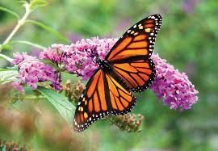
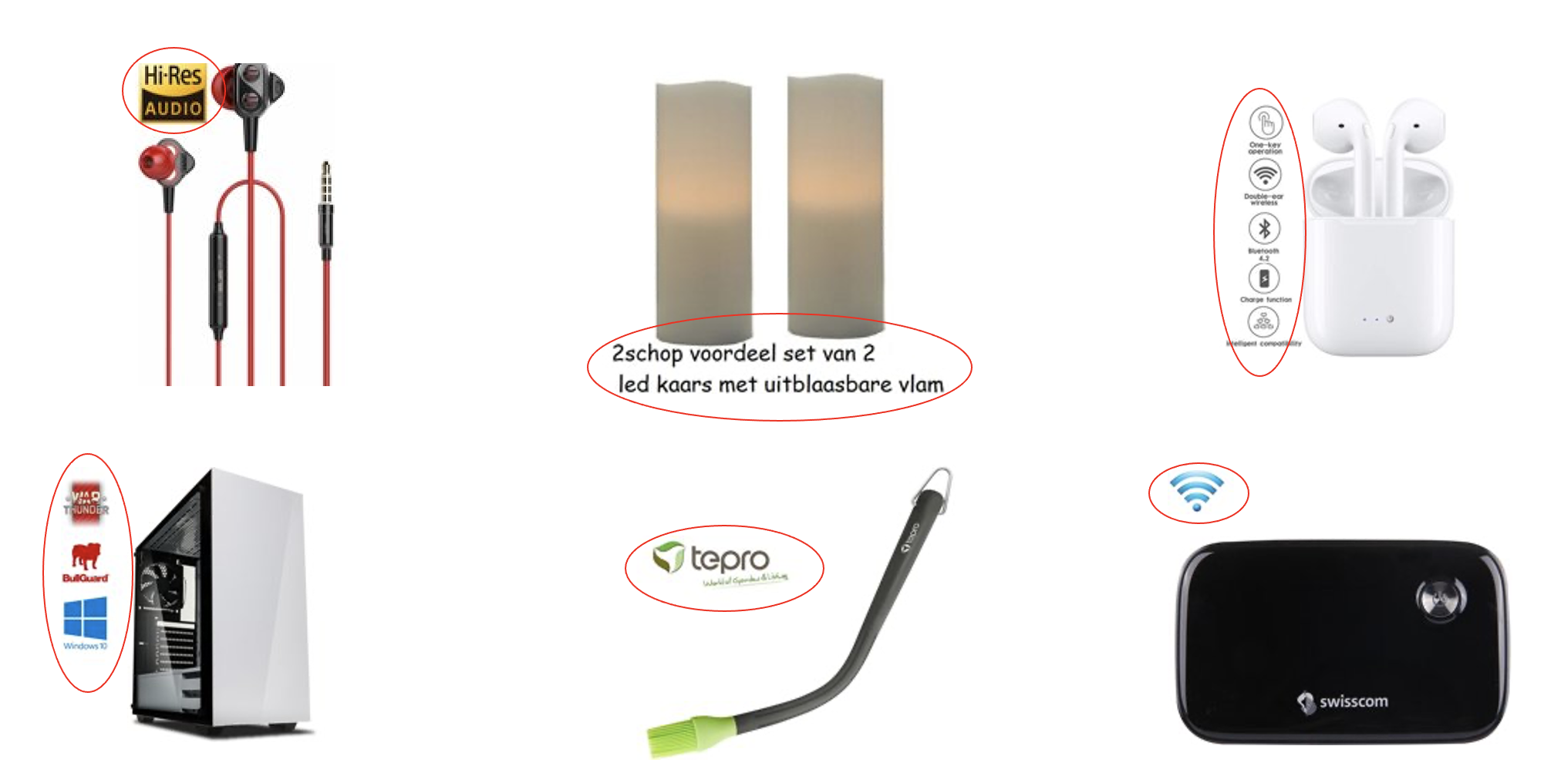
Butterfly
What does it do?
Detect overlays on images
Why do we need it?
Overlays are not permitted in advertisement images
Where is it used
Advertisement pipeline

Slide 10

Workshop

Slide 11

What do do?
Assignment
Build a forecasting model for book sales
Go through the notebook step by step
How?
Create 4 roughly equal groups
Make sure Python savy people are spread across the groups
We are here to help, ask us anything ☺

Slide 12

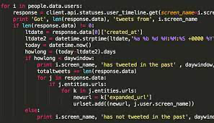
Where to start
Go to: [LINK TO GITHUB PAGE WHERE TO CODE WILL BE]
Download notebooks and data via and Download ZIP
Unpack zip file locally
Go to: http://colab.research.google.com
Login with google account
Open notebook
File > Upload file bolcom_books_assignment.ipynb
Upload data file
Side bar > files > upload file bol_books.csv
Run notebook
Runtime > Run all (Will fail at first cell with TODO)
Start coding

Slide 13
Thanks

